Slide 1
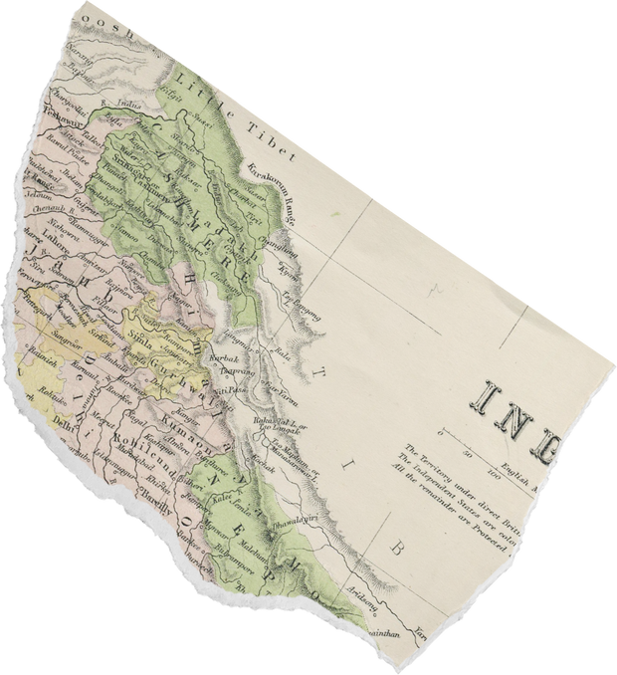
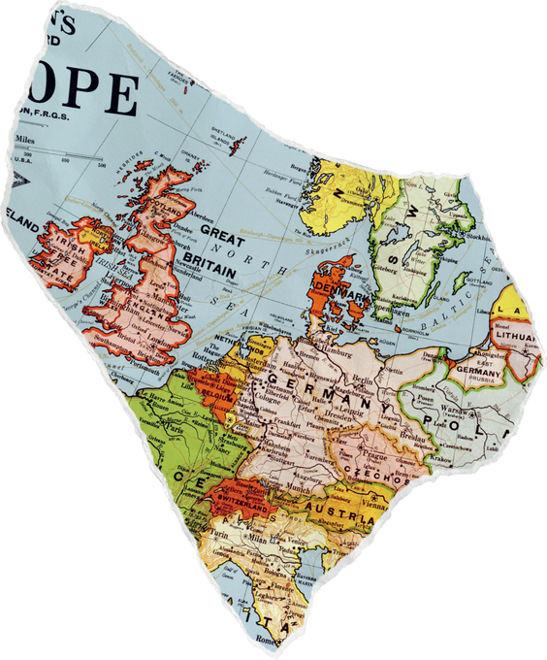
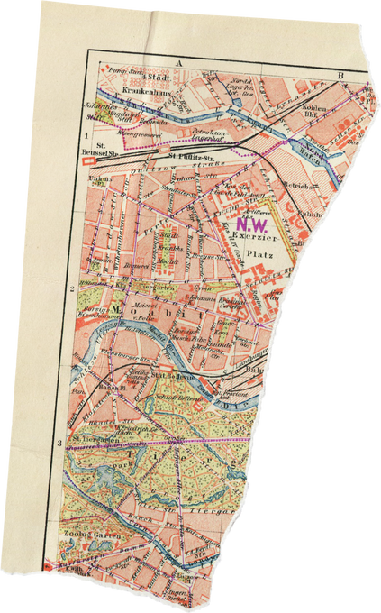
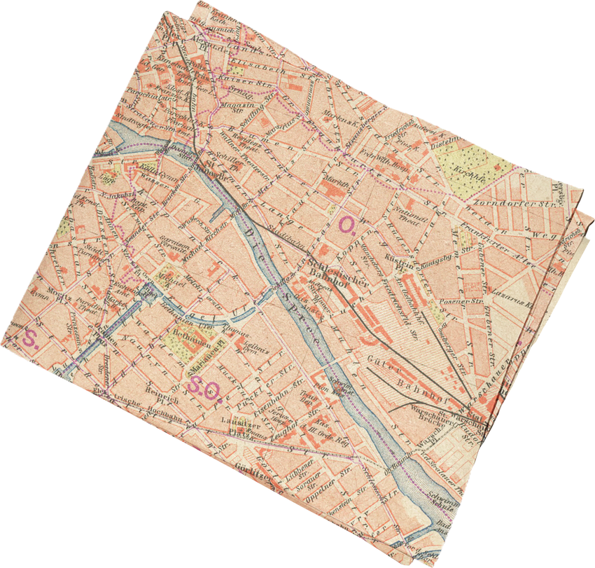
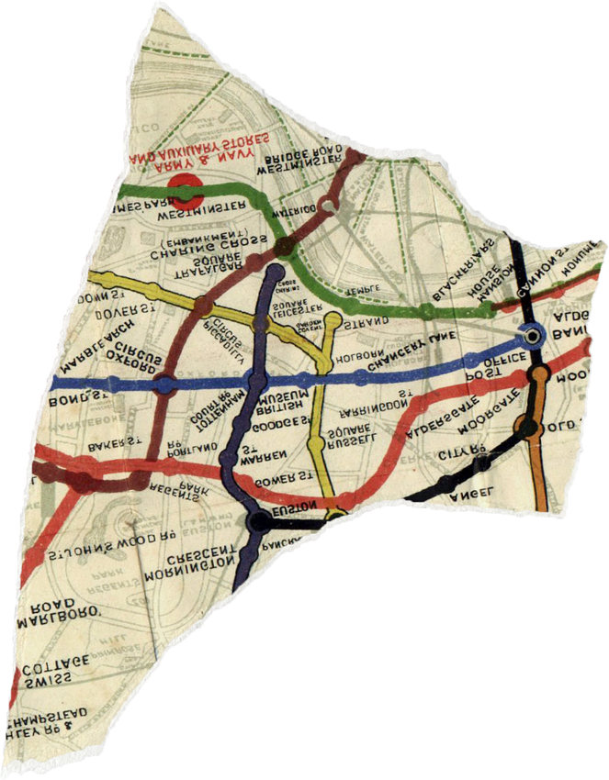
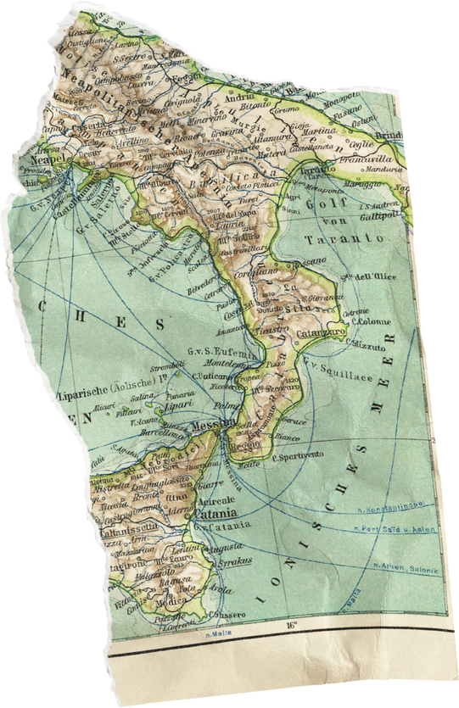

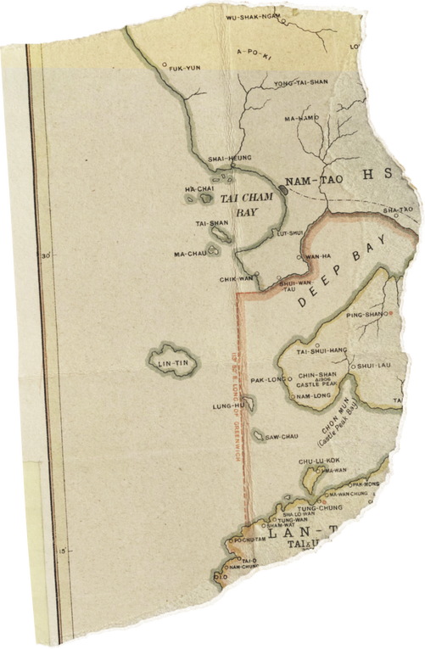
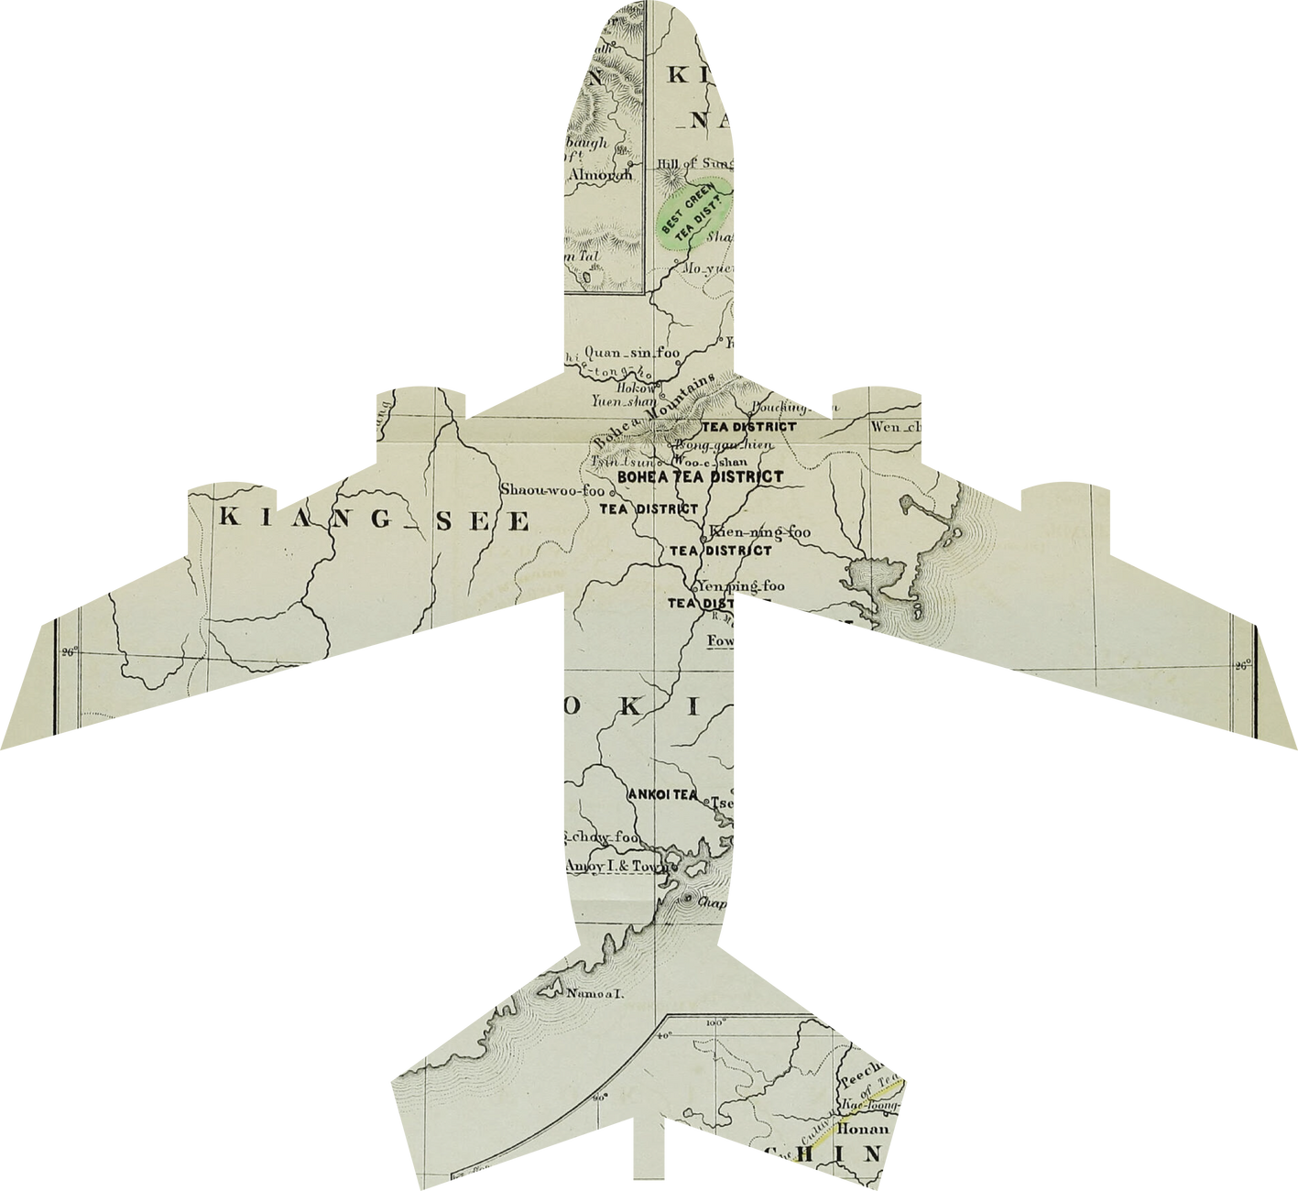

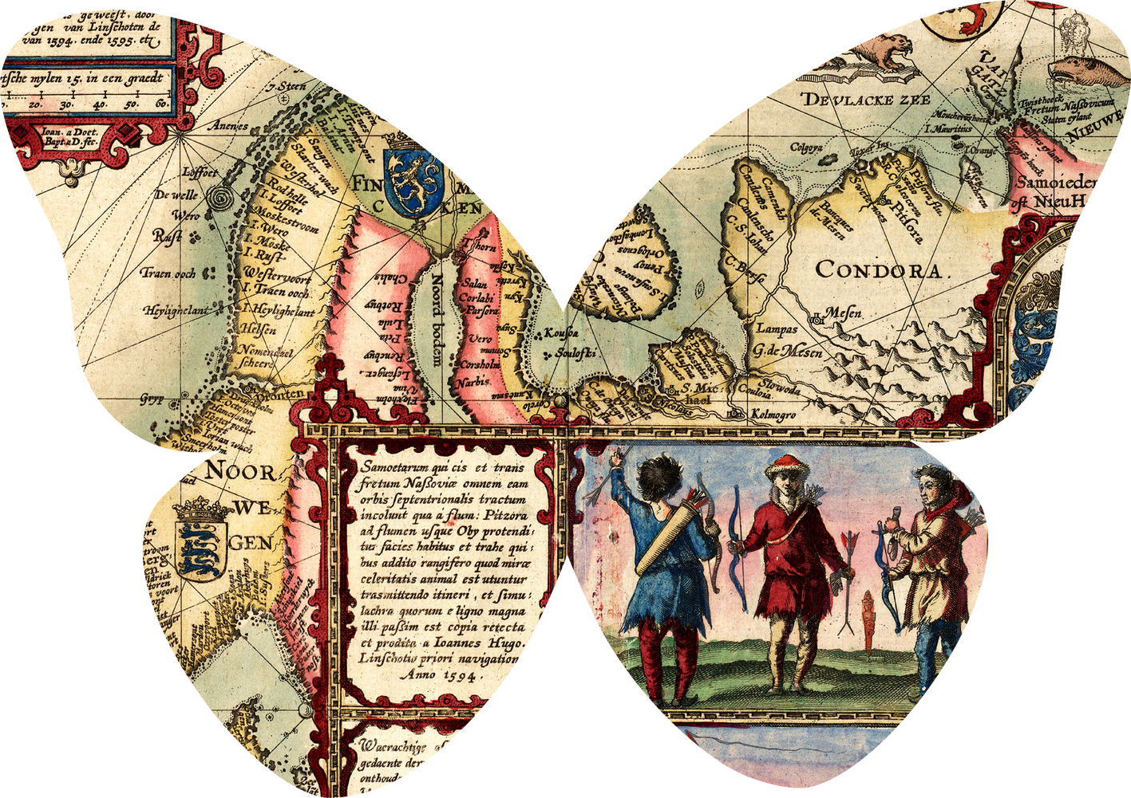
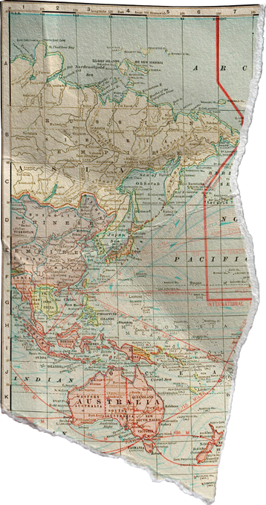
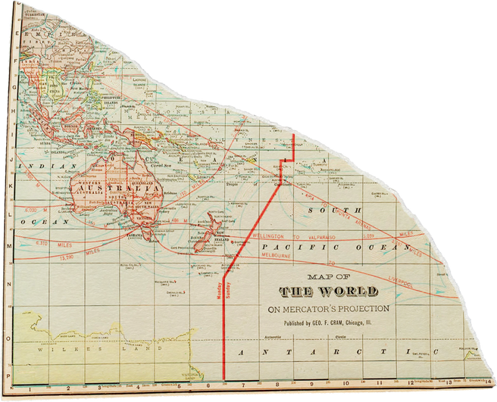
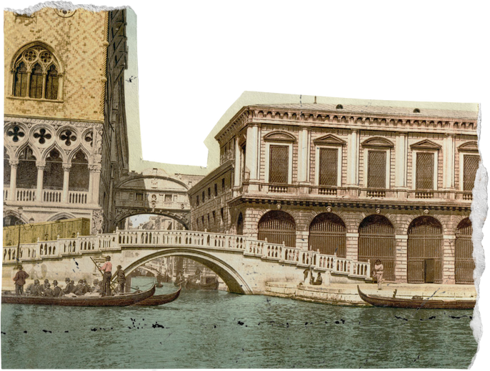

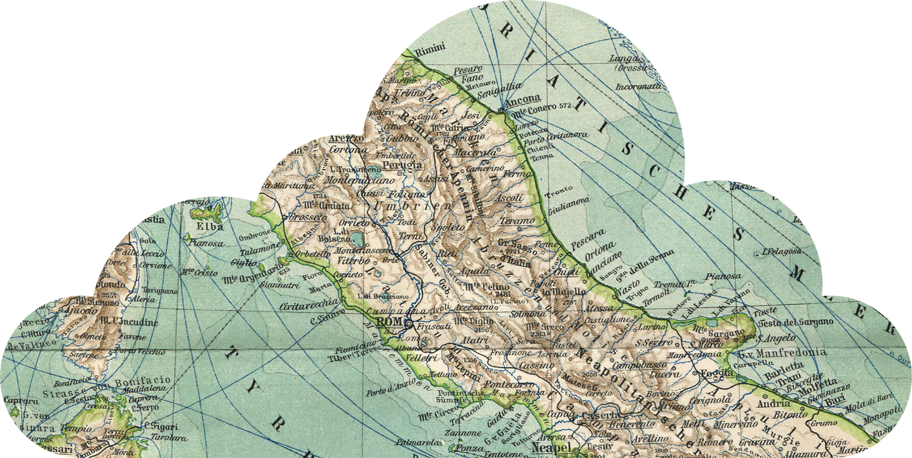
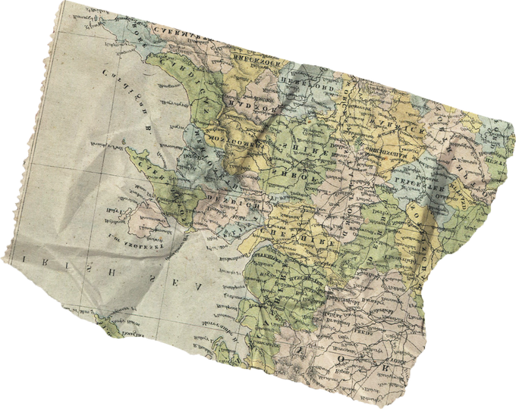
Metro Route Xpert

Slide 2

Introduction:
The "MetroRouteXpert" web application aims to simplify commuting on the Delhi metro system by providing a user-friendly interface for easy route planning and fare estimation.
It leverages comprehensive data on station locations, line trajectories, and fare structures to offer accurate, cost-effective journey plans.
By engaging with commuters to understand their needs, the project tailors its features to enhance user experience.
Feasibility studies ensure the technical, financial, and operational viability of the project, addressing resource availability, cost-effectiveness, and regulatory compliance to ensure successful implementation and adoption.

Slide 3

TECH Stack
"MetroRouteXpert“ enhances commuting efficiency by providing the shortest path options, saving valuable time in a busy city like Delhi. It also optimizes costs for budget-conscious users by identifying the least expensive routes, especially during multiple transfers or peak hours.
Utilizing a modern tech stack with React for the frontend and Flask for the backend, it positions the Delhi Metro as a technologically progressive organization, attracting talent and paving the way for future advancements.

Slide 4

Frontend Methodology
User Interface Design: The user interface will follow user-centered design principles to ensure ease of navigation, featuring input fields with autocomplete or dropdown functionality for selecting starting and destination stations. Leaflet.js will be used to integrate an interactive map of the Delhi Metro network, highlighting stations, lines, and connections. Route details, including distance, estimated travel time, and fare information, will be displayed dynamically, along with detailed cards for each station on the route.
Map Visualization: The Leaflet.js map will be customized to accurately represent the Delhi Metro network, with markers for stations and polylines for metro lines and connections. The map will dynamically update based on user input, highlighting the shortest path to visually confirm the selected route.

Slide 5

Backend Methodology
Flask Server Setup: The Flask application will be organized using best practices like the MVC architecture for readability and scalability. RESTful API endpoints will be defined to handle user inputs and return shortest path details. The server will implement request handling logic to parse inputs, validate data, and invoke functions for path calculation.
Shortest Path Calculation: The Delhi Metro network will be represented as a graph data structure with stations as nodes and connections as edges. Dijkstra's algorithm will be used to calculate the shortest path between selected stations, considering distance, travel time, and fare. The route details, including total distance, estimated travel time, and fare, will be formatted into a JSON response for the frontend.

Slide 6
Challenages
Data Collection: Obtaining accurate and comprehensive data on the metro network, including station locations, connections, and distances, was challenging. Significant data cleaning was necessary to address inconsistencies, missing values, and inaccuracies.
Algorithm Selection: Selecting the right algorithm for calculating the shortest path was crucial, requiring consideration of efficiency, accuracy, and scalability to ensure optimal route planning.
Map Visualization: Creating an intuitive and interactive map of the metro network was challenging. It required balancing detailed information with clarity and usability for user navigation.
Route Details and Fare Calculation: Providing detailed route information, including total distance, estimated travel time, and fare calculation, was essential. The application needed to accurately calculate fares based on distance, fare zones, and applicable discounts or surcharges.

Slide 7
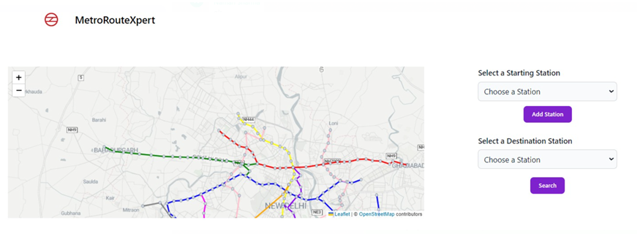
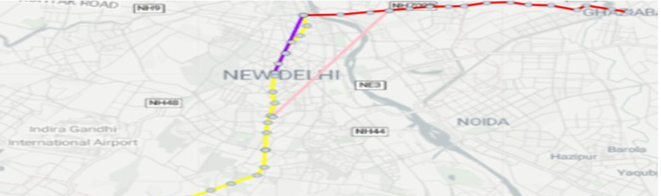
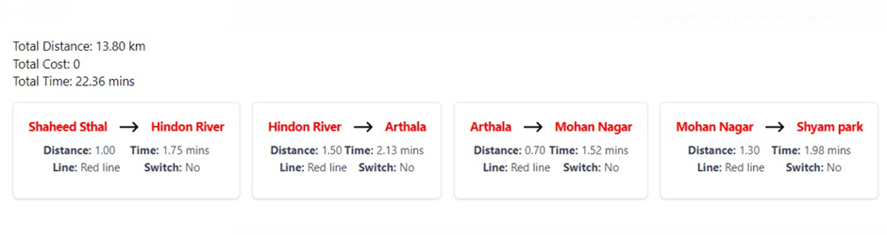
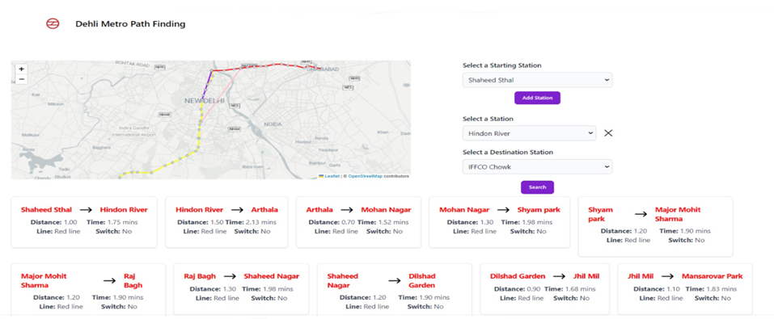
Results

Slide 8
Real-time Integration: Integrate with the Delhi Metro's real-time data feeds to display live updates on delays, disruptions, and platform changes. This would provide users with the most up-to-date information for informed travel decisions.
01.
Future Scope
Multimodal Integration: Expand the scope beyond the metro by incorporating other modes of transportation like buses, rickshaws, or carpooling services. This would create a comprehensive travel planning platform for users seeking the most efficient route combinations.
02.
03.
Expanding Scope to Other Cities: Consider adapting the website model for other Indian cities with metro networks, potentially creating a national multi-city journey planner platform.

Slide 9

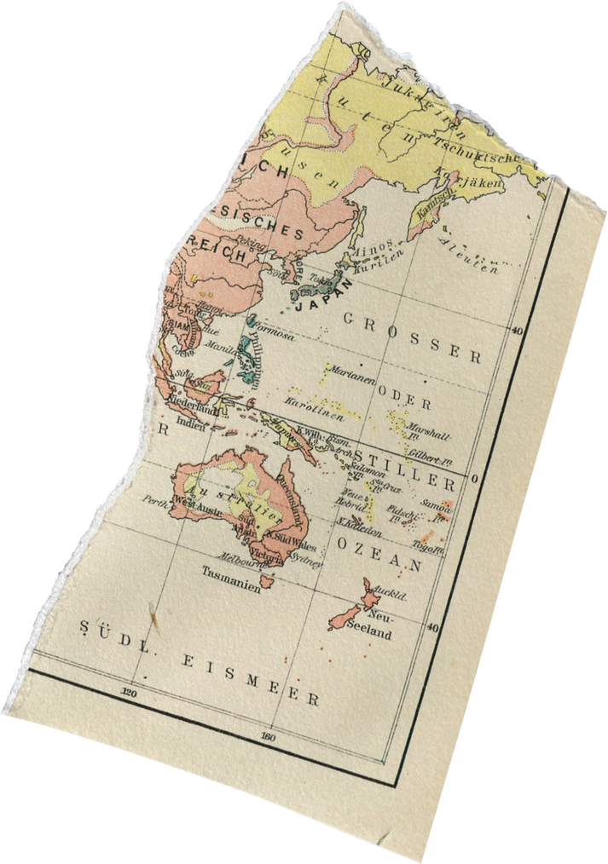
Conclusion
The MetroRouteXpert website offers users with a seamless experience, allowing them to easily input their starting and destination stations, visualize the metro network on a map, and receive detailed route information including distance, travel time, and fare calculation.
Additionally, the integration of fare calculation adds another layer of functionality, enhancing the overall utility of the application.

Slide 10
Thank you very much!

